Slide 1
Lab 6 Figures
Brittany Hupp
Principle Components Analysis I

Slide 2
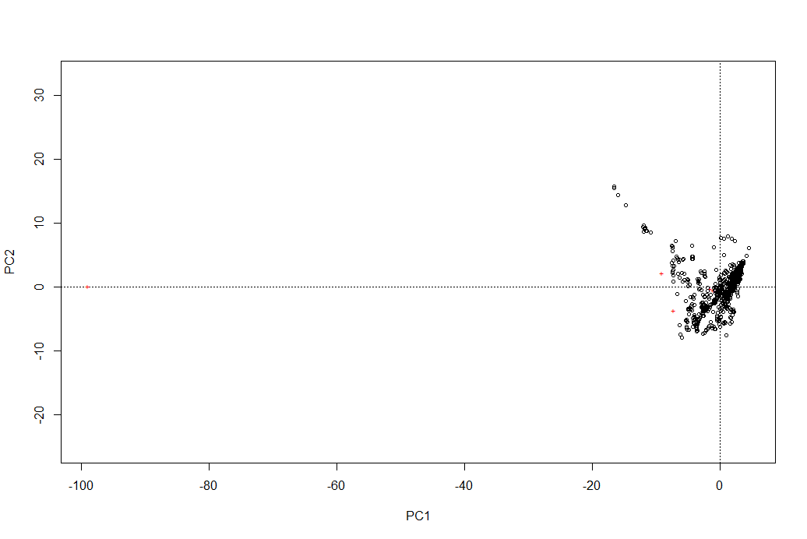
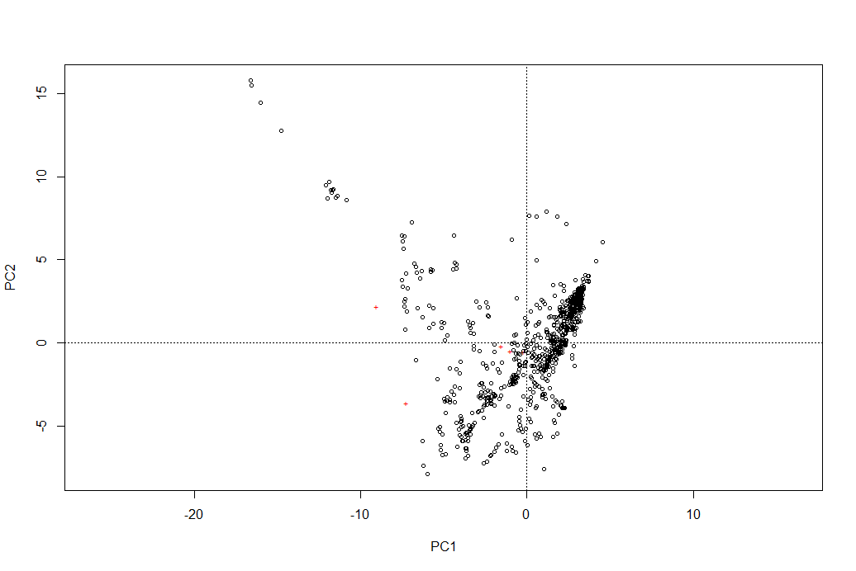
Arctic Data: PC1 vs. PC2 w/ and w/o outlier

Slide 3
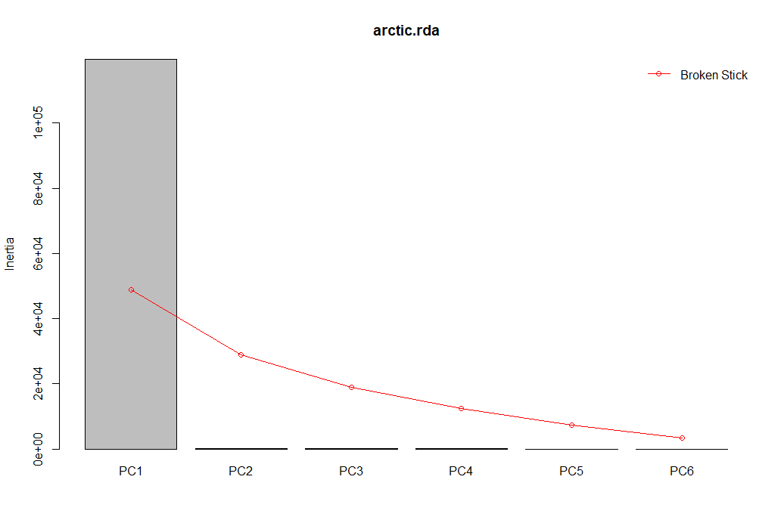
Arctic Data: Screeplot with Broken Stick Model

Slide 4
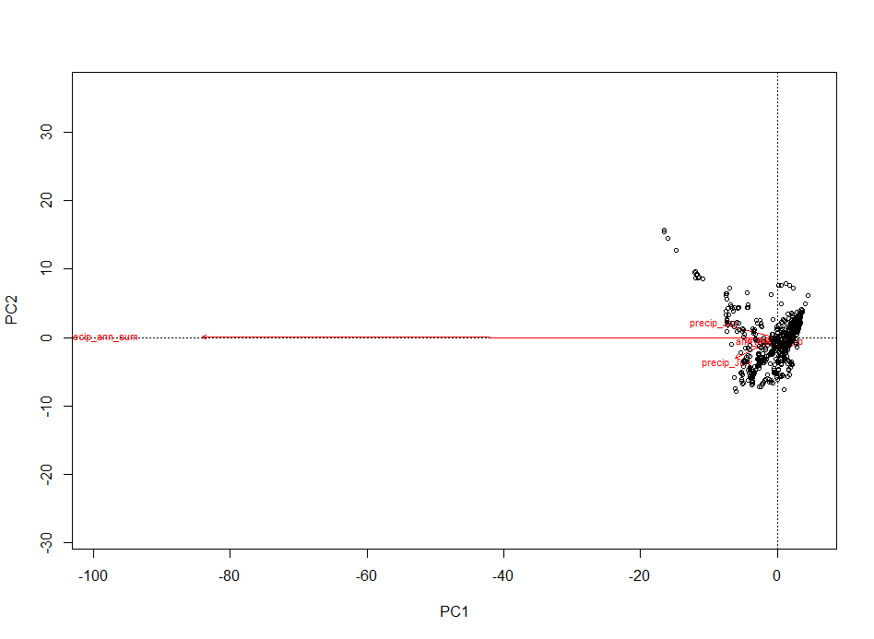
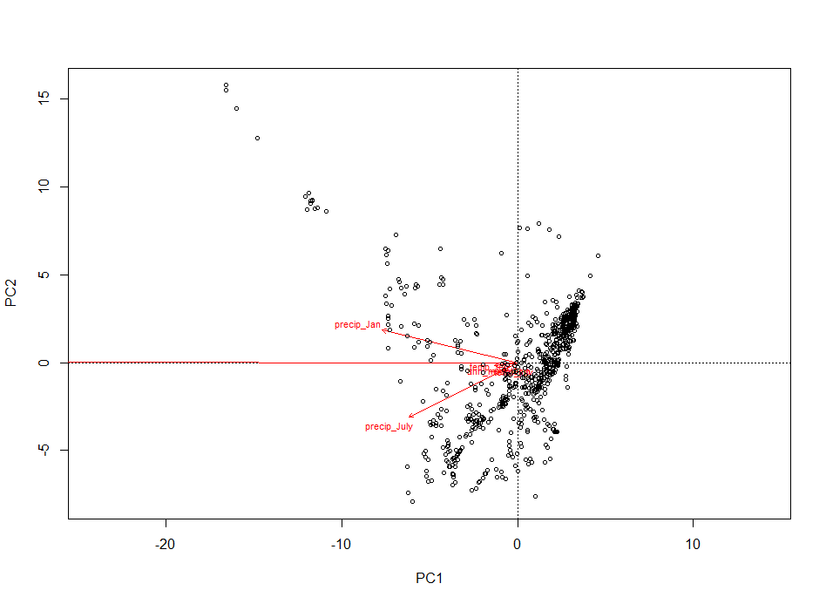
Arctic Data: Ordination Plot w/ and w/o Outlier (RDA Vegan)
Dry and Cold
Wet and Cold
Wet and Warm
Dry and Warm

Slide 5
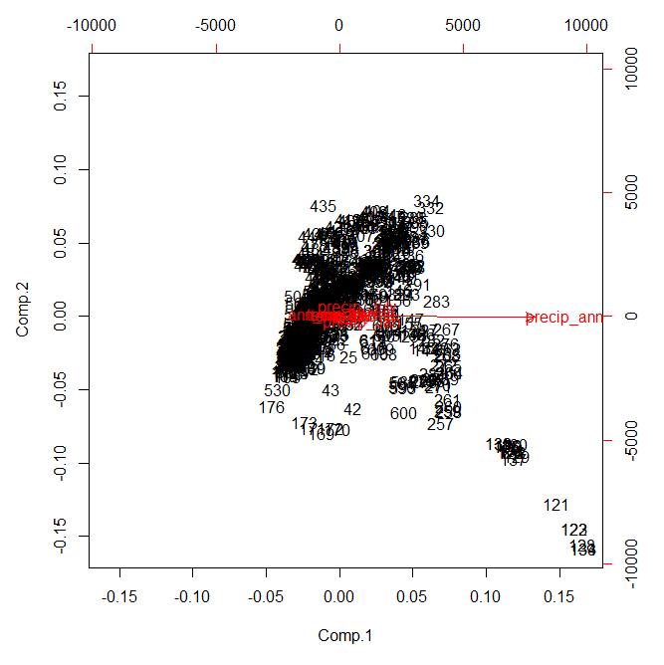
Arctic Data: Ordination Plot w/ and w/o Outlier (Princomp)

Slide 6
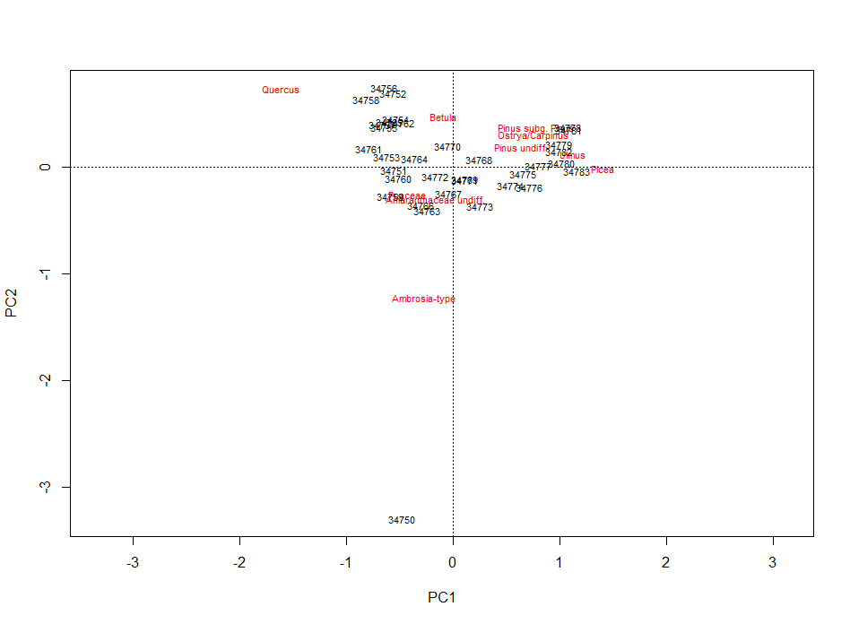
Mendota D Core: PC1 vs. PC2

Slide 7
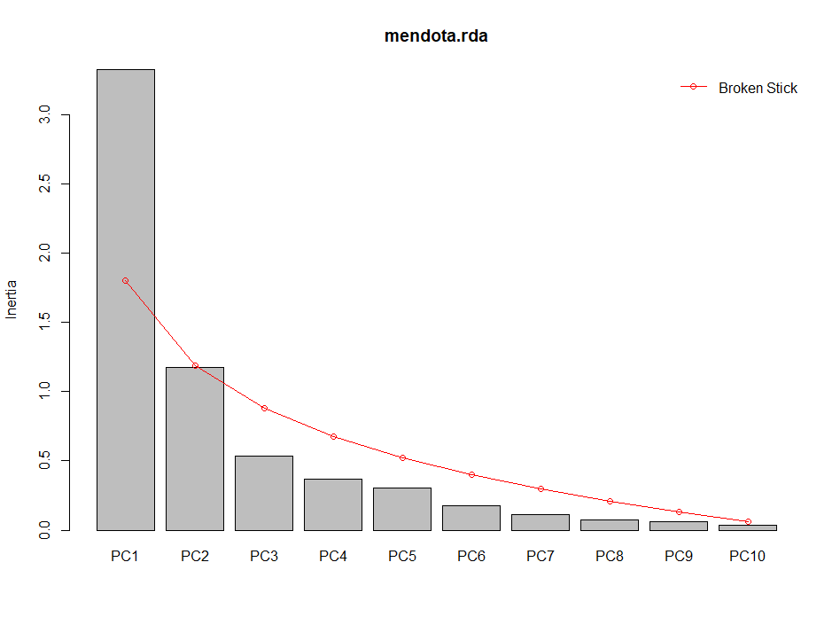
Mendota D Core: Screeplot with Broken Stick Model

Slide 8
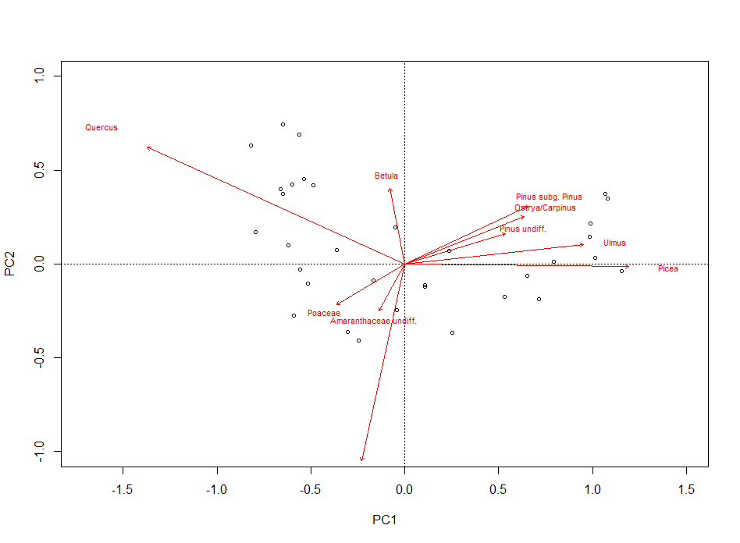
Mendota D: Ordination Plot (RDA Vegan)

Slide 9
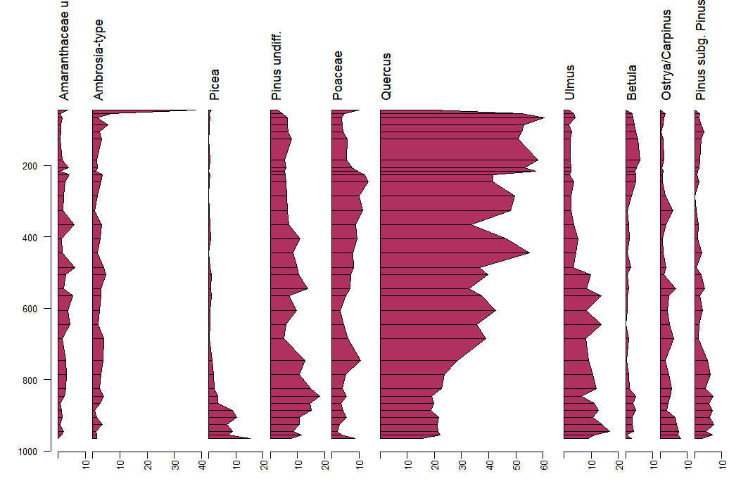
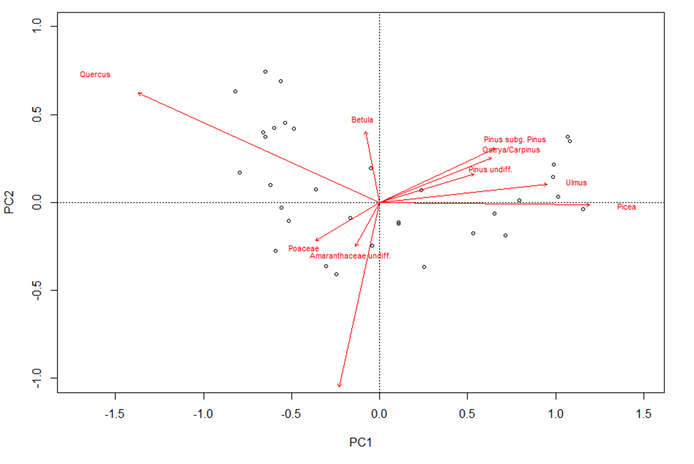
Mendota D Core: Ordination Plot & Pollen Diagram

